Slide 1

Customer Shopping Behavior Analysis
Uncovering insights from 3,900 purchases to drive strategic business decisions. I did this data analytics project to demonstrate my hard skills. This presentation is made by Gamma AI

Slide 2


PROJECT OVERVIEW
Understanding Customer Patterns
This comprehensive analysis examines transactional data from 3,900 purchases across multiple product categories. The goal: uncover actionable insights into spending patterns, customer segments, product preferences, and subscription behavior.
By combining Python data analysis, SQL queries, and Power BI visualization, I transformed raw data into strategic business intelligence. I used JupyterLab, PostGreSQL, and Microsoft Power BI respectively.

Slide 3
Dataset at a Glance
3,900
18
$59.76
3.75
Total Purchases
Data Features
Avg Purchase
Avg Rating
Comprehensive transaction records analyzed
Customer demographics and purchase details
Mean transaction value across all customers
Customer satisfaction score
Demographics
Purchase Details
Shopping Behavior
Age, gender, location, subscription status
Item, category, amount, season, size, color
Discounts, promo codes, purchase frequency, reviews, shipping

Slide 4

Data Preparation with Python
01
Data Loading & Exploration
Imported dataset using pandas, checked structure with df.info() and summary statistics
02
Missing Data Handling
Imputed 37 missing Review Rating values using median rating per product category
03
Feature Engineering
Created age_group bins and purchase_frequency_days columns for deeper analysis
04
Database Integration
Connected to PostgreSQL and loaded cleaned data for SQL analysis

Slide 5
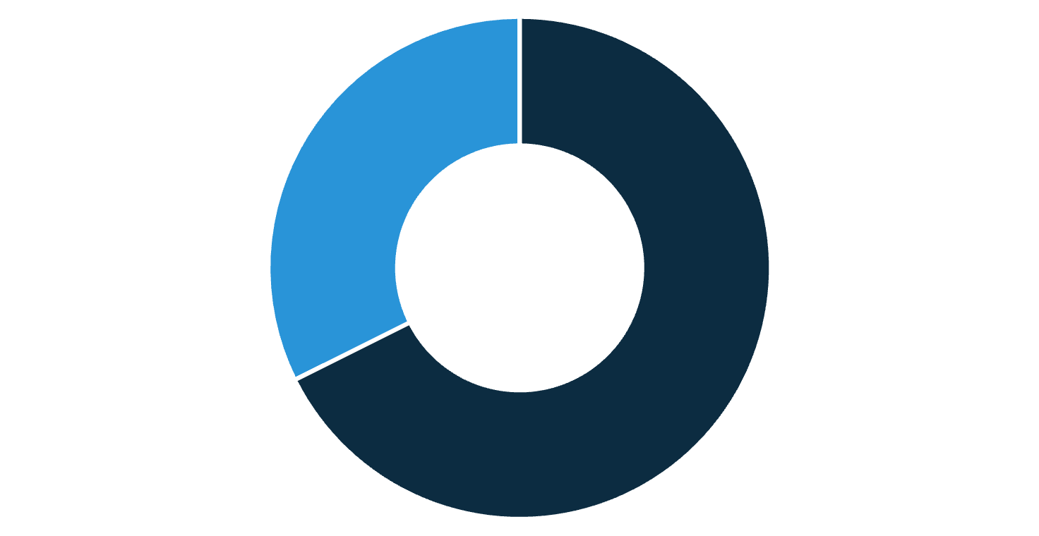
Revenue Insights by Gender
Male Customers Drive Revenue
Male customers generated $157,890 in total revenue, more than double the $75,191 from female customers. This 68% male revenue share suggests opportunities for targeted marketing campaigns.
Understanding gender-based purchasing patterns can help optimize product offerings and promotional strategies.
Male
Female

Slide 6




Key SQL Analysis Findings
Smart Discount Users
Top-Rated Products
Shipping Preferences
Subscription Impact
839 customers used discounts but still spent above average ($59.76), showing price-conscious yet high-value buyers
Gloves (3.86), Sandals (3.84), and Boots (3.82) lead in customer satisfaction ratings
Express shipping customers spend $60.48 on average vs. $58.46 for standard—a $2 premium
1,053 subscribers contribute $62,645 total revenue with $59.49 average spend, similar to non-subscribers

Slide 7
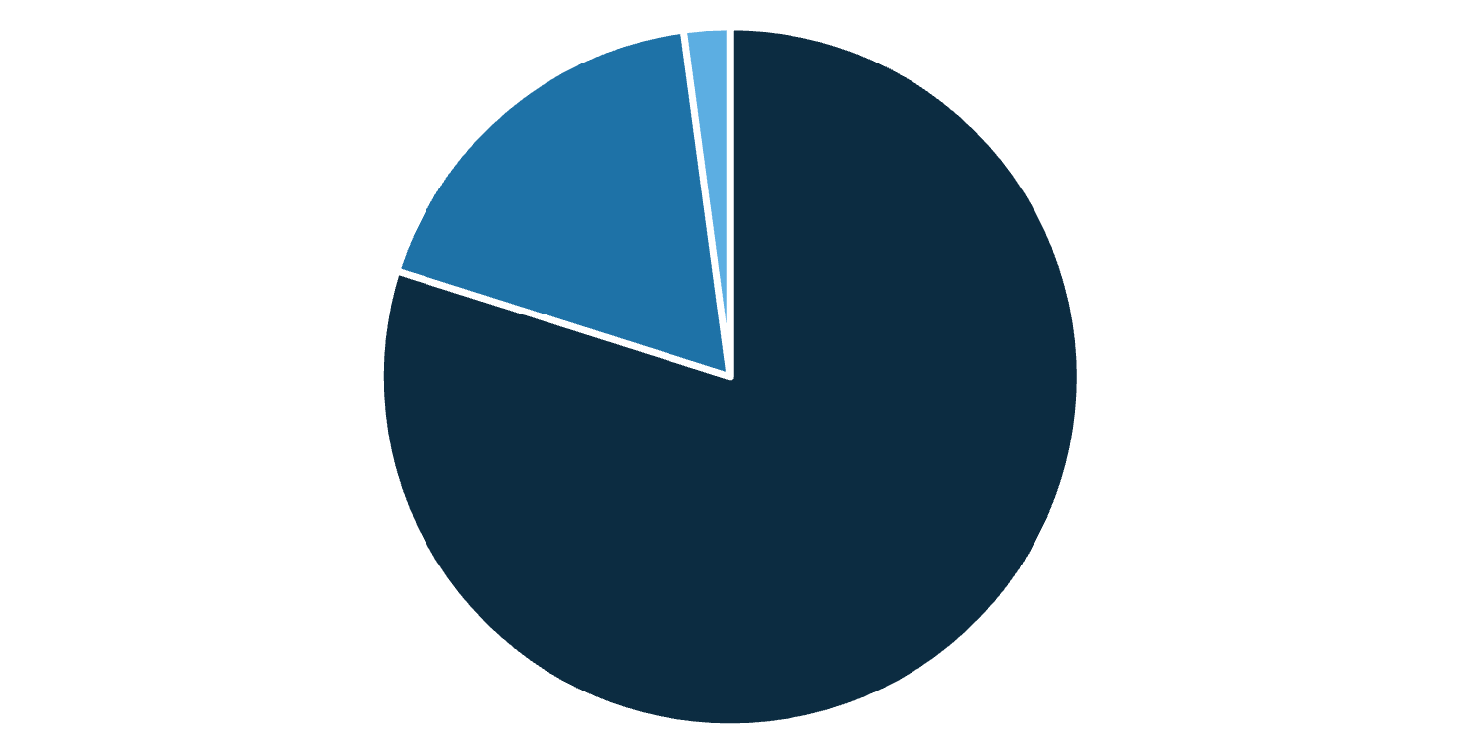
Customer Segmentation Analysis
Loyalty Drives Business
Our segmentation reveals a strong loyal customer base of 3,116 customers (80% of total), with 701 returning customers and just 83 new customers.
Additionally, 958 of the 3,074 repeat buyers (>5 purchases) have subscriptions, while 2,518 do not—indicating untapped subscription potential among loyal customers.
Loyal
Returning
New

Slide 8




Power BI Dashboard Highlights
3.9K Customers
$59.76 Avg Purchase
3.75 Avg Rating
Total customer base analyzed
Mean transaction value
Customer satisfaction score
Subscription Split
Category Leaders
Age Group Insights
27% subscribed, 73% non-subscribers—major growth opportunity
Clothing dominates with $100K revenue and 1,800 sales
Young Adults lead revenue at $62K, followed by Middle-aged at $59K

Slide 9
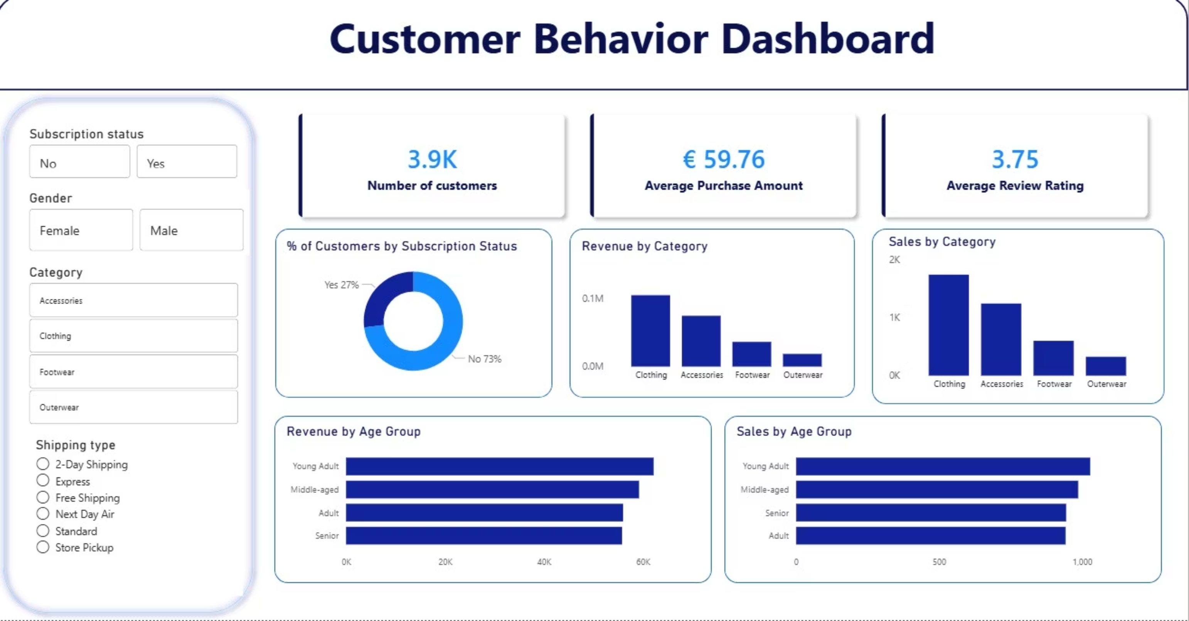
From the POWER BI Visualization in Detail

Slide 10
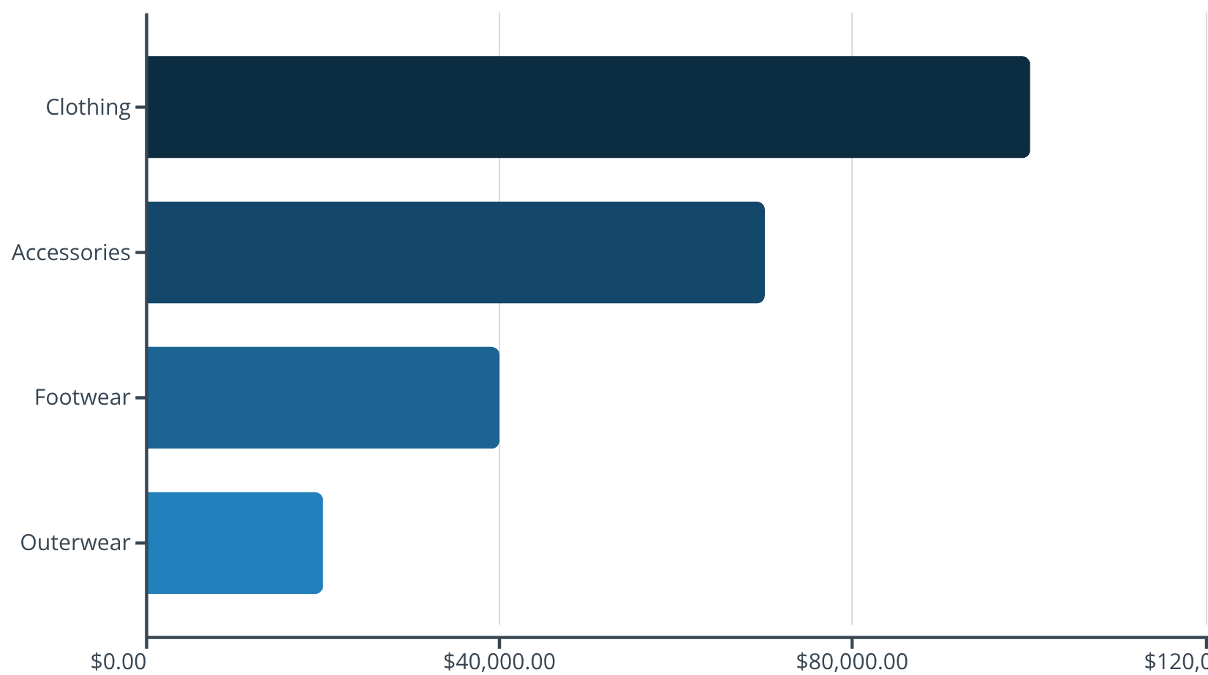
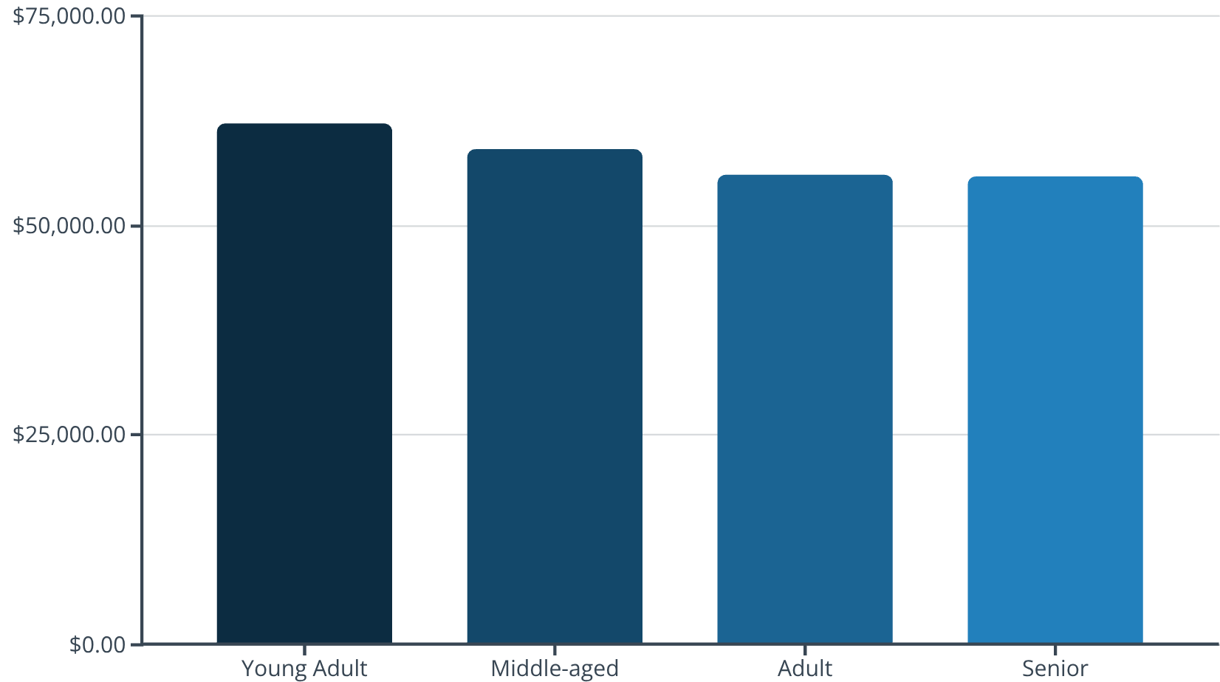
Revenue Distribution Analysis

Slide 11




STRATEGIC RECOMMENDATIONS
Actionable Business Insights
Boost Subscriptions
Loyalty Programs
Promote exclusive benefits to convert the 73% non-subscribers, especially among loyal repeat buyers
Reward repeat buyers to accelerate movement into the "Loyal" segment and increase lifetime value
Review Discount Policy
Targeted Marketing
Balance promotional sales boosts with margin control—839 high-spenders use discounts strategically
Focus campaigns on Young Adults, express-shipping users, and top-rated products like Gloves and Sandals

